Slide 1

ILP 2022 – W3S1 For loops iterations, generators
Matthieu DE MARI – Singapore University of Technology and Design

Slide 2
Outline (Week3, Session1 – W3S1)
The list type (quick intro, much more to come on W3)
The for statement
The range() generator
The enumerate() generator
The zip() generator
Nesting for loops
Breaking for loops

Slide 3
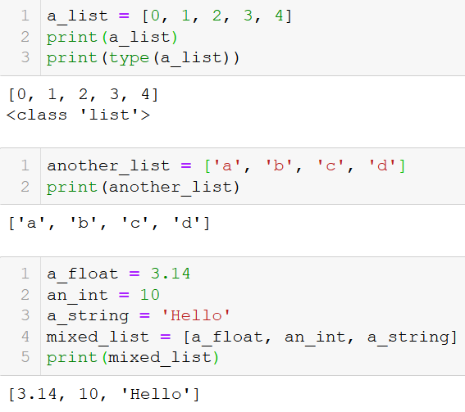
The list type
Let us first introduce a new type of objects, called lists.
Definition (lists): a list is a sequence of several variable elements, listed in order, between brackets and separated by commas.
It can contain variables of any types (int, float, string, etc.).
List can also contain mixed types of variables.

Slide 4
The list type
We will learn more about lists on the next two sessions!

Slide 5
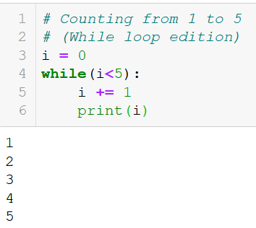
The for statement
Sometimes in programming, there is a block of code that you want to repeat for a fixed number of times.
It could be done with a while statement, but there is a more convenient way.
More convenient way: the for statement is used to repeat a given block of code for a given number of times.

Slide 6
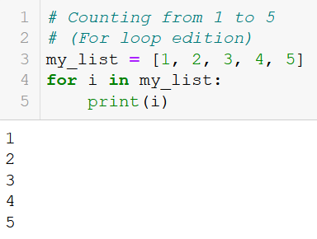
The for statement
The for loop - How it works:
Use the for keyword,

Slide 7
The for statement
The for loop - How it works:
Use the for keyword,
It is immediately followed by a variable name, called an iteration variable,

Slide 8
The for statement
The for loop - How it works:
Use the for keyword,
It is immediately followed by a variable name, called an iteration variable,
Use the in keyword to indicate that the iteration variable will take values in a given list,

Slide 9
The for statement
The for loop - How it works:
Use the for keyword,
It is immediately followed by a variable name, called an iteration variable,
Use the in keyword to indicate that the iteration variable will take values in a given list,
Provide a list object, finish with a : symbol.

Slide 10
The for statement
The for loop - How it works:
Use the for keyword,
It is immediately followed by a variable name, called an iteration variable,
Use the in keyword to indicate that the iteration variable will take values in a given list,
Provide a list object, finish with a : symbol.
Indent some code to be repeated inside the for, as in if/while.

Slide 11
The for statement
The for loop - How it works:
Use the for keyword,
It is immediately followed by a variable name, called an iteration variable,
Use the in keyword to indicate that the iteration variable will take values in a given list,
Provide a list object, finish with a : symbol.
Indent some code to be repeated inside the for, as in if/while.
Notice how the iteration variable value changes after each repetition of the code inside the for loop.

Slide 12
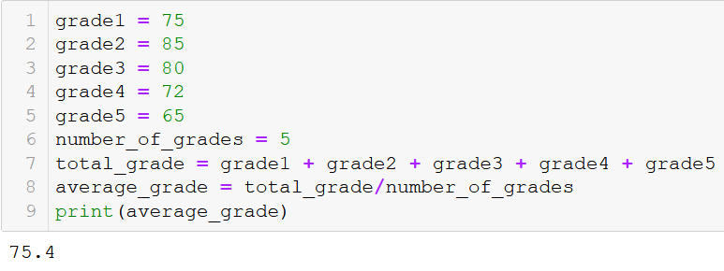
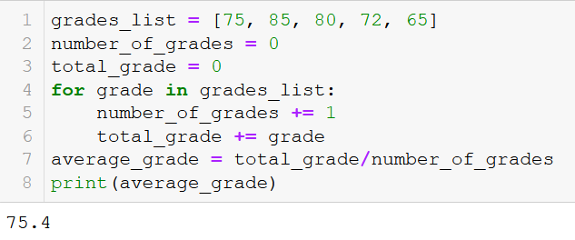
An example: average grade for student
Not using a for loop: lots of variables
Using a for loop
Lots of variable
Long code
Cleaner and shorter code
Modular (works with any number of grades in list)

Slide 13
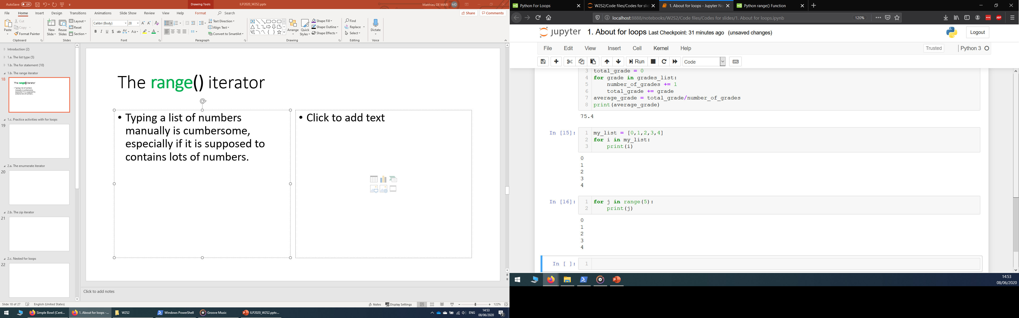
The range() generator
Problem: typing a list of numbers manually is cumbersome, especially if it is supposed to contain lots of elements/numbers.

Slide 14
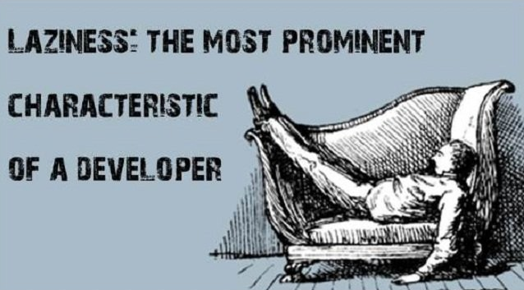
The range() generator
Problem: typing a list of numbers manually is cumbersome, especially if it is supposed to contain lots of elements/numbers.

Slide 15
The range() generator
Solution: The range() generator can be used to replace the list object in the for loop definition.

Slide 16
The range() generator
Solution: The range() generator can be used to replace the list object in the for loop definition.
It receives an integer n.
Here, range(n) means: the iteration variable will take n successive values, starting from 0 and incrementing by 1 each time.

Slide 17
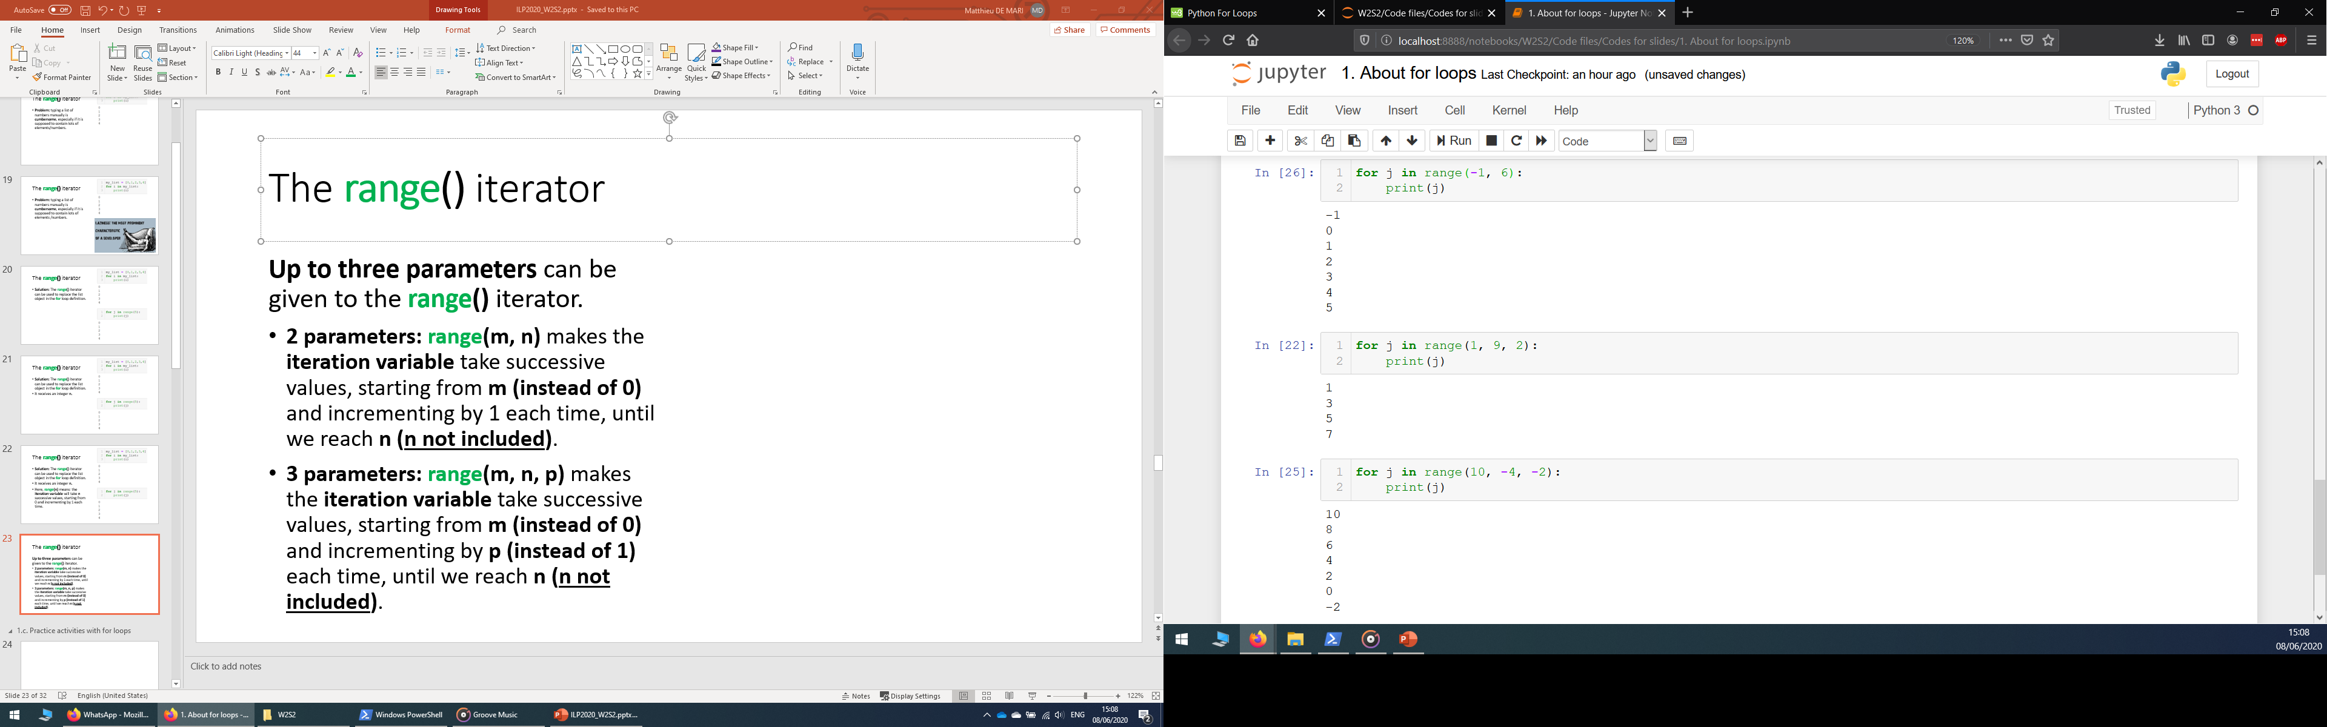
The range() generator
Up to three parameters can be given to the range() generator.
2 parameters: range(m, n) makes the iteration variable take successive values, starting from m (instead of 0) and incrementing by 1 each time, until we reach n (n not included).

Slide 18
The range() generator
Up to three parameters can be given to the range() generator.
2 parameters: range(m, n) makes the iteration variable take successive values, starting from m (instead of 0) and incrementing by 1 each time, until we reach n (n not included).
3 parameters: range(m, n, p) makes the iteration variable take successive values, starting from m (instead of 0) and incrementing by p (instead of 1) each time, until we reach n (n not included).

Slide 19
The range() generator
Up to three parameters can be given to the range() generator.
2 parameters: range(m, n) makes the iteration variable take successive values, starting from m (instead of 0) and incrementing by 1 each time, until we reach n (n not included).
3 parameters: range(m, n, p) makes the iteration variable take successive values, starting from m (instead of 0) and incrementing by p (instead of 1) each time, until we reach n (n not included).
Note: if two or more parameters are used, we can play with negative values.

Slide 20
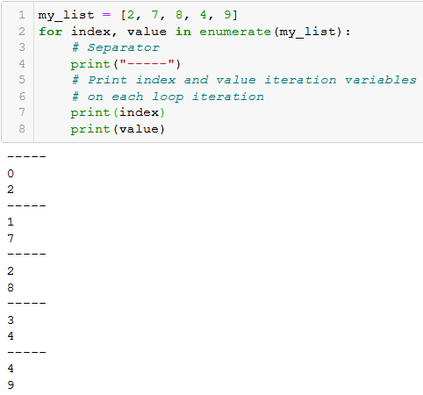
The enumerate() generator
The enumerate() generator can be used to update two iteration variables at once.

Slide 21
The enumerate() generator
The enumerate() generator can be used to update two iteration variables at once. On each loop iteration:
The first one takes values consisting of the position index (1st, 2nd,3rd,… element),
The second is takes value of the element in the list.

Slide 22
The enumerate() generator
The enumerate() generator can be used to update two iteration variables at once. On each loop iteration:
The first one takes values consisting of the position index (1st, 2nd,3rd,… element),
The second is takes value of the element in the list.
Note: In Python, we start counting from 0. What we call the 1st element of the list in English, is called the 0th element (index = 0) in programming.

Slide 23
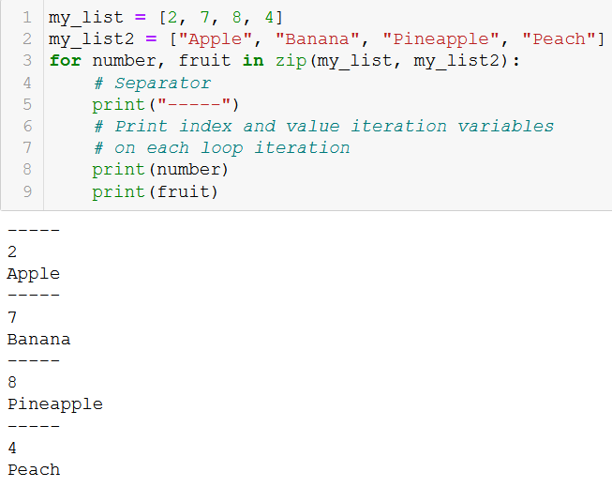
The zip() generator
Want to browse through the elements of multiple lists at the same time?
Use the zip() generator!

Slide 24
The zip() generator
Want to browse through the elements of multiple lists at the same time?
Use the zip() generator!
The zip() generator takes multiple lists of equal length (same number of elements).

Slide 25
The zip() generator
Want to browse through the elements of multiple lists at the same time?
Use the zip() generator!
The zip() generator takes multiple lists of equal length (same number of elements).
Updates that many iteration variables on each loop iteration, in a synchronized manner.

Slide 26
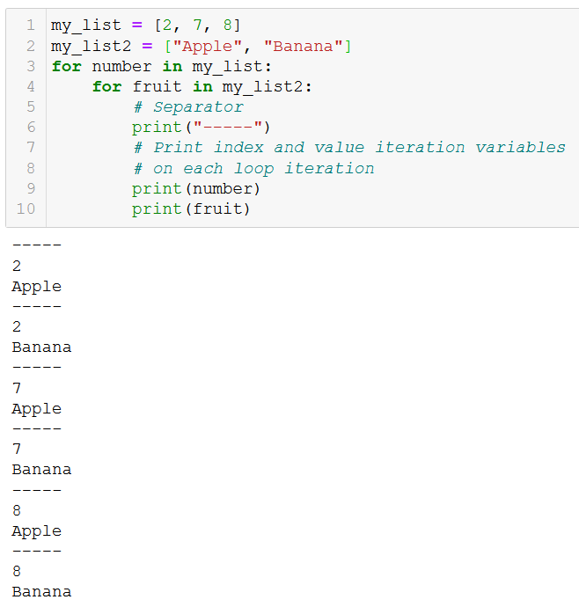
Nesting for loops
Just like we nested if statements earlier, we can nest for loops.

Slide 27
Nesting for loops
Just like we nested if statements earlier, we can nest for loops.
Works “almost” like the zip generator,

Slide 28
Nesting for loops
Just like we nested if statements earlier, we can nest for loops.
Works “almost” like the zip generator,
But updates the iteration variables in an unsynchronized manner.

Slide 29
Nesting for loops
Just like we nested if statements earlier, we can nest for loops.
Works “almost” like the zip generator,
But updates the iteration variables in an unsynchronized manner.
Convenient for checking all combinations of values in two given lists!

Slide 30
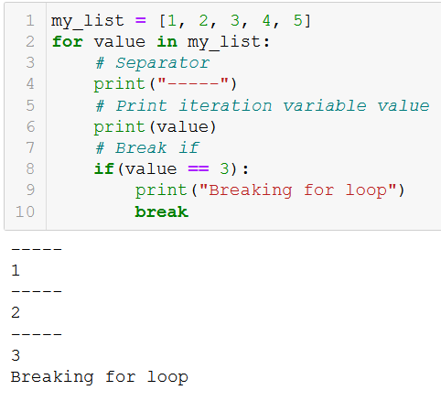
The break statement (episode 2)
In W2S1, we have seen how the break statement can be used to interrupt a while loop.
It also works with for loops!

Slide 31
To recap
We have seen multiple ways to make for loops work
Pass a list: easiest way, browse through each element one by one.

Slide 32
To recap
We have seen multiple ways to make for loops work
Pass a list: easiest way, browse through each element one by one.
The range() generator: Replace a list of regularly spaced values with a range() generator, as to avoid having to type the elements of the list manually.

Slide 33
To recap
We have seen multiple ways to make for loops work
Pass a list: easiest way, browse through each element one by one.
The range() generator: Replace a list of regularly spaced values with a range() generator, as to avoid having to type the elements of the list manually.
The enumerate() generator: Updates two iteration variables at once, one being the position index of the element in the list, and the second being the value of said element in list.

Slide 34
To recap
We have seen multiple ways to make for loops work
Pass a list: easiest way, browse through each element one by one.
The range() generator: Replace a list of regularly spaced values with a range() generator, as to avoid having to type the elements of the list manually.
The enumerate() generator: Updates two iteration variables at once, one being the position index of the element in the list, and the second being the value of said element in list.
The zip() generator: Browse through multiple lists elements in a synchronized manner.

Slide 35
To recap
We have seen multiple ways to make for loops work
Pass a list: easiest way, browse through each element one by one.
The range() generator: Replace a list of regularly spaced values with a range() generator, as to avoid having to type the elements of the list manually.
The enumerate() generator: Updates two iteration variables at once, one being the position index of the element in the list, and the second being the value of said element in list.
The zip() generator: Browse through multiple lists elements in a synchronized manner.
Nesting for loops: Browse through multiple lists elements in an unsynchronized manner.

Slide 36
Practice activities: basic for loops
Let us practice a bit with for loops, with the following activities
Activity 1 - How many items in my inventory.ipynb
Activity 2 - Best equipment finder.ipynb
Activity 3 - Best equipment finder v2.ipynb
Activity 4 - Find the missing card.ipynb

Slide 37
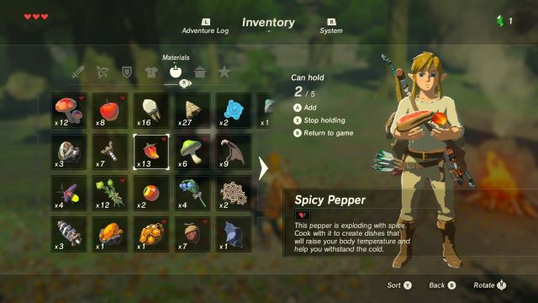
Activity 1 - How many items in my inventory
In several video games, the main character will have an inventory, i.e. a list of items that he/she is carrying at the moment.

Slide 38
Activity 1 - How many items in my inventory
In several video games, the main character will have an inventory, i.e. a list of items that he/she is carrying at the moment. This inventory could be defined as a list, as shown below.
inventory = ["Sword", "Armor", "Potion", "Potion", "Torch", "Potion", "Bow", "Potion", "Torch", "Potion"]

Slide 39
Activity 1 - How many items in my inventory
In several video games, the main character will have an inventory, i.e. a list of items that he/she is carrying at the moment. This inventory could be defined as a list, as shown below.
inventory = ["Sword", "Armor", "Potion", "Potion", "Torch", "Potion", "Bow", "Potion", "Torch", "Potion"]
Our objective is to write a function how_many_items(), which:
receives an inventory list, such as the one above, as its first parameter,
receives an item name, as a second parameter (e.g. item_name = "Torch")
and returns the number of times the item in question appears in the inventory.

Slide 40
Activity 2 - Best equipment finder
Let us define an inventory list, below, which contains a list of weapons that our character has acquired during gameplay.
inventory = ["Dull Sword", "Wooden Branch", "Master Sword", "Iron Sword", "Silver Sword"]

Slide 41
Activity 2 - Best equipment finder
Let us define an inventory list, below, which contains a list of weapons that our character has acquired during gameplay.
inventory = ["Dull Sword", "Wooden Branch", "Master Sword", "Iron Sword", "Silver Sword"]
Let us also consider we have been given a second list, which contains the attack points for each weapon currently in inventory, in order:
weapon_stats = [1, 1, 10, 5, 8]

Slide 42
Activity 2 - Best equipment finder
Let us define an inventory list, below, which contains a list of weapons that our character has acquired during gameplay.
inventory = ["Dull Sword", "Wooden Branch", "Master Sword", "Iron Sword", "Silver Sword"]
Let us also consider we have been given a second list, which contains the attack points for each weapon currently in inventory, in order:
weapon_stats = [1, 1, 10, 5, 8]
Write a function maximal_attack_points(), which
receives the weapon_stats list as its only parameter,
and returns the maximal attack points we would have if we were to equip the best weapon currently in inventory.

Slide 43
Activity 3 - Best equipment finder v2
Let us define an inventory list, below, which contains a list of weapons that our character has acquired during gameplay.
inventory = ["Dull Sword", "Wooden Branch", "Master Sword", "Iron Sword", "Silver Sword"]
Let us also consider we have been given a second list, which contains the attack points for each weapon currently in inventory, in order:
weapon_stats = [1, 1, 10, 5, 8]
Task: As in activity 2, but I want the name of the best weapon to be returned instead of the maximal attack points I would obtain if I decided to equip it!

Slide 44
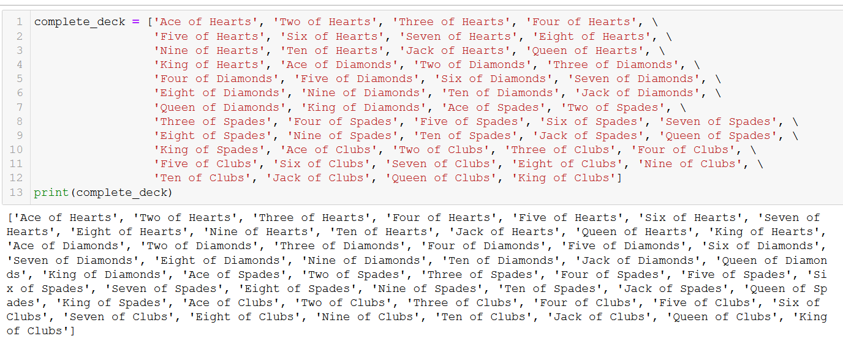
Activity 4 - Find the missing card

Slide 45
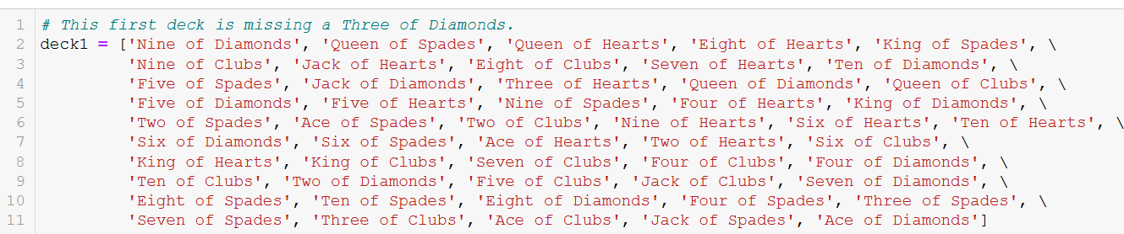
Activity 4 - Find the missing card

Slide 46
Activity 4 - Find the missing card
Write a function find_missing_card(), which receives a complete deck of cards as its first parameter, and receives a second deck, as its second parameter.
The second deck is a standard deck that has been shuffled and may be missing a single card.
The function find_missing_card() should return the name of the one card that is missing in the second deck. It should return None, if no card is missing.
Note that:
The decks are missing one card at most,
The decks will contain no duplicates.

Slide 47
Conclusion
The list type (quick intro, more to come on W3S1)
The for statement
The range() generator
The enumerate() generator
The zip() generator
Nesting for loops
Breaking for loops

Slide 48

The continue statement
Similar to the break statement, which was be used to interrupt a while/for loop…
We can define the continue statement!

Slide 49
The continue statement
Similar to the break statement, which was be used to interrupt a while/for loop…
We can define the continue statement!
When encountered in the indented code inside a loop, it ends the current iteration and moves on to the next one.

Slide 50
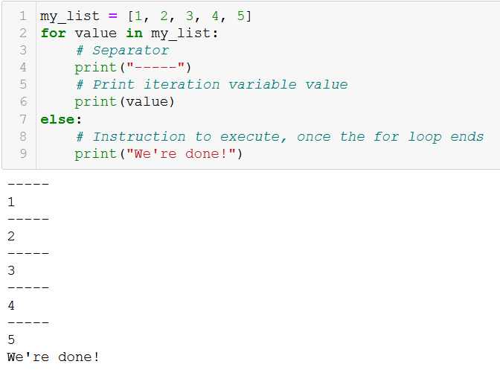
The else statement (episode 2)
Similar to the else statement, which was used in if statements…
We can define the else statement in for loops.

Slide 51
The else statement (episode 2)
Similar to the else statement, which was used in if statements…
We can define the else statement in for loops.
It defines a piece of code to be executed when the for loop ends normally.
Normally: completed all iterations, not interrupted by a break.

Slide 52
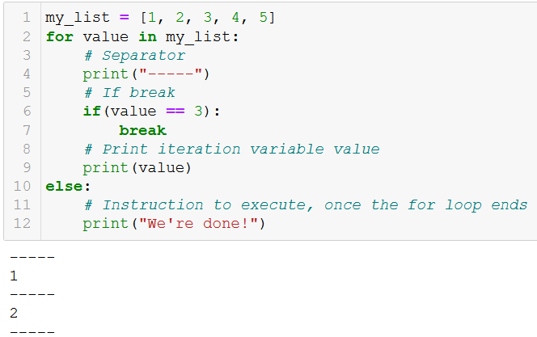
The else statement (episode 2)
Similar to the else statement, which was used in if statements…
We can define the else statement in for loops.
It defines a piece of code to be executed when the for loop ends normally.
Normally: completed all iterations, not interrupted by a break.

